Slide 1
Procedures
Abdul Haseeb

Slide 2
Introduction
Assembly language program can be organized into procedures
What happens when one procedure makes call to other procedure?

Slide 3
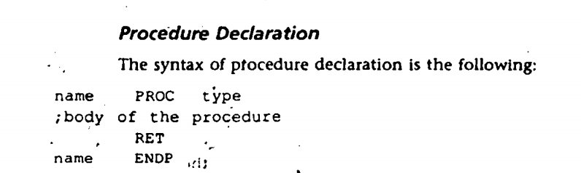
Declaration of Procedure

Slide 4
NEAR vs FAR
Near:
If type of procedure is omitted, it is considered Near
It means that the calling procedure and called procedure are in same segment (like package has classes)
Far:
It means calling and called procedure are in different segments

Slide 5
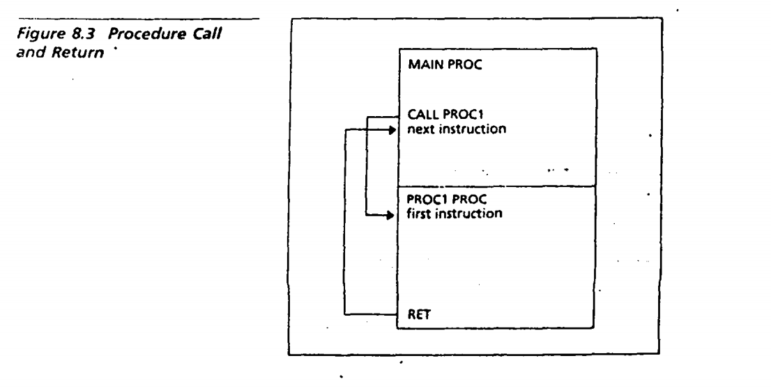

Slide 6
RET
Returns control to the calling procedure
Every procedure except main procedure must have a RET as the last statement

Slide 7
Communication between Procedures
No Parameters in assembly
Programmer will have to devise a way to exchange values between procedures
One solution can be to store them in registers

Slide 8
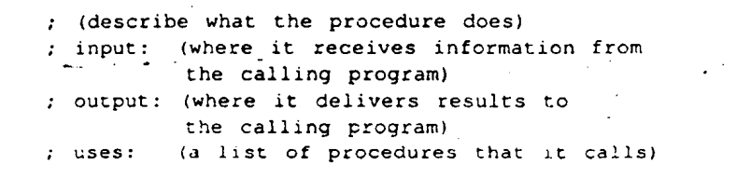
Documentation
For clarity, a procedure should be documented with the help of comments

Slide 9
Calling a Procedure
Direct call vs Indirect Call
CALL address_expression
CALL name

Slide 10
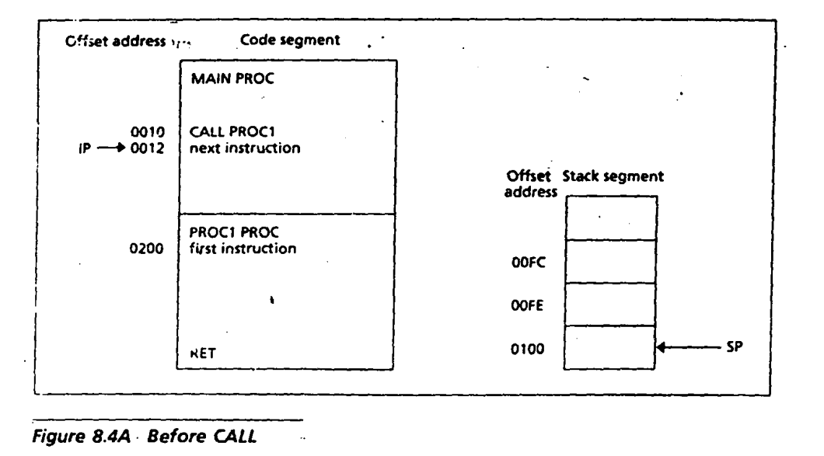

Slide 11
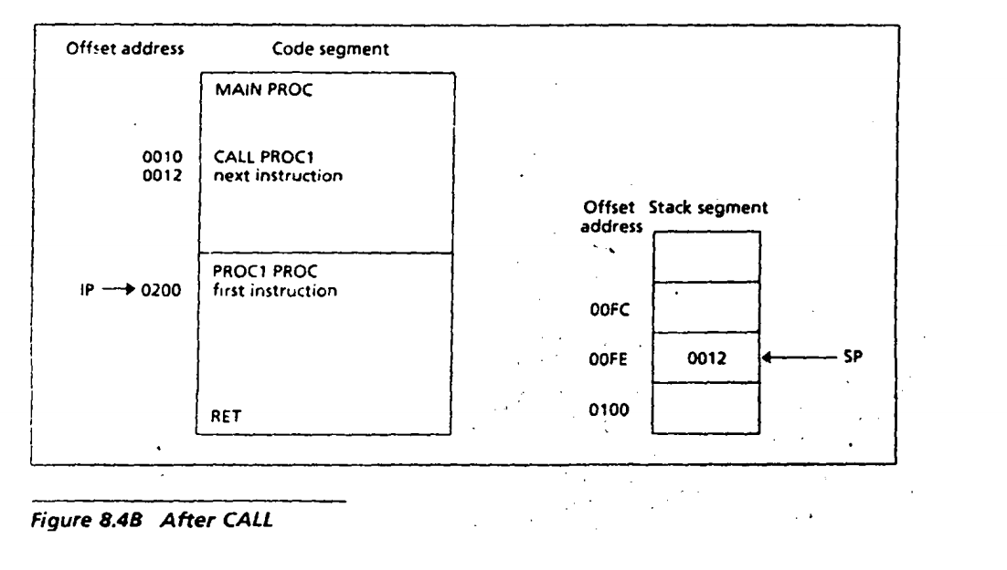

Slide 12
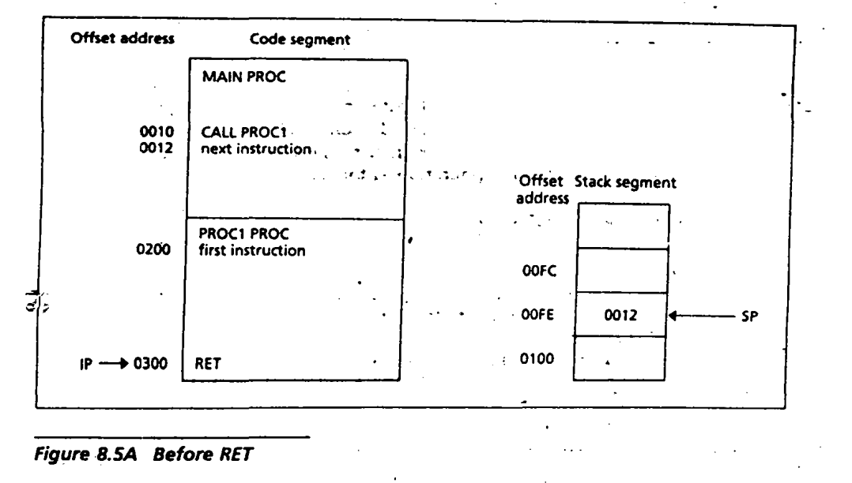

Slide 13
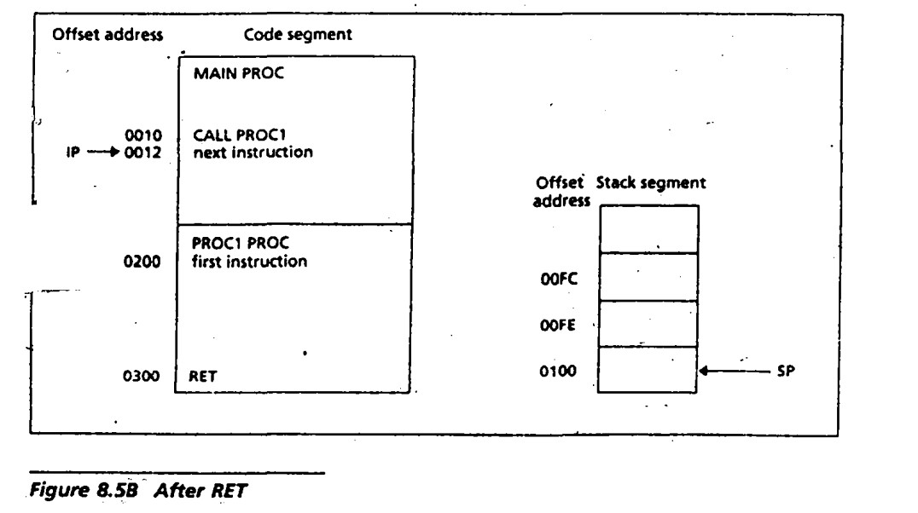

Slide 14
Tasks
Create a Procedure named new_line, which adds a new line on console
Create a Procedure named case_convert, which converts an alphabet letter from lower case to upper case
Create a Procedure named Addition, which performs addition of two numbers
Inside main method Take two numbers and one small alphabet character as Input, Each input should be taken on a new line, Use Procedure for adding a new line
Use Addition Procedure to perform Addition of those numbers which were taken as Input
Display a new line with the help of Procedure
Use case_convert to convert the letter from lowercase to Uppercase

